Slide 1
CASCADeS:
Collaborative Adaptation of Service Models for Child And family health in Diverse Settings
CASCADES Framework
© Stockton

Slide 2
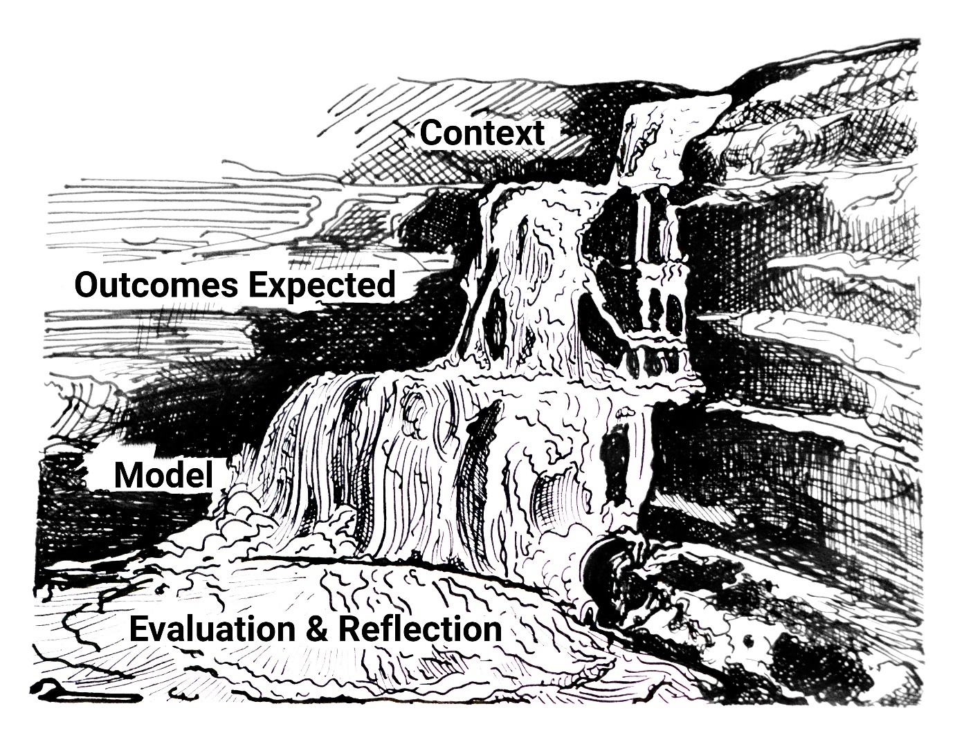
A Framework to Guide Us: C-O-M-E
Meeting 1: Setting the Scene
Meeting 2: Context
What we know about our community and the needs of families?
Meeting 3: Outcomes expected
What difference are we hoping we make?
Meeting 4: Model
A look at the current service model – what’s working, what might need to change?
Meeting 5: Evaluate & Reflect
Updating / Revisions to the Service Model
Implementation Recommendations
Evaluation Strategy
Between Workshops:
Collecting information to inform actions and planning
CASCADES Framework
© Stockton

Slide 3
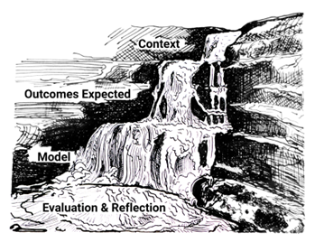
Tier 1: Context
What do we know about the communities we serve?
the needs of the families,
strengths,
vulnerabilities
barriers to access
enablers?
Are there existing service gaps, the resources available, and opportunities for collaboration.
What data might we need to access to test or check our beliefs or assumptions?
Tier 1 Focus Questions (Resources Toolbox)
CASCADES Framework
© Stockton

Slide 4
Developing our Work Plan
Service Stream Sub-Groups?
Timeframe?
Agreed Actions from today…
Meeting dates / times?

Slide 5
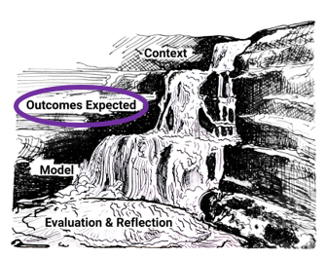
Next: Tier 2 – Outcomes Expected
Tier 2 focuses on the outcomes you would expect to see if your service model if effective in making the difference you hope for
Consider:
what benefits are we seeking to achieve;
what difference are we hoping to make;
are these outcomes meaningful to families, or services or both?
What data will we need as a baseline, so we can compare data sets after changes have been implemented to measure change?
The focus questions in the CASCADeS Resources Toolkit are provided as a guide to discussion amongst your group members.
The answers to these questions will be informed by your collective understanding of your local community context, gained through the insights and knowledge shared in Tier 1 – Context.
CASCADES Framework
© Stockton

Slide 6
Next Steps
Focus Questions Tier 2 – Outcomes Expected
Check in with:
Colleagues
Clients?
Form Outcomes Statements
Next meeting date

Slide 7
Any Questions?

